Slide 1
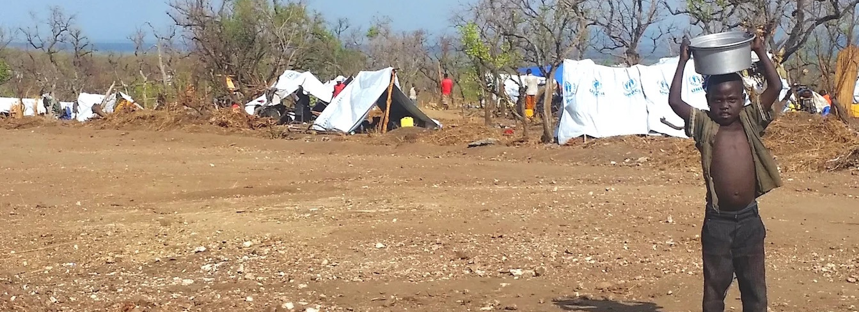

NATIONAL ASSOCIATION OF CONGREGATIONAL CHRISTIAN CHURCHES
GLOBAL MISSION PARTNERS

Slide 2
OUR MISSION
To nurture fellowship among Congregational Christian churches and to support ministries of the local church in its community and to the world, all in the name of Christ.

Slide 3
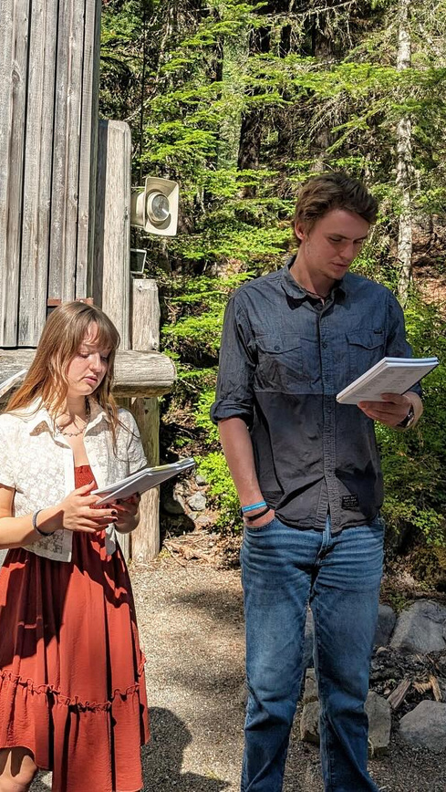
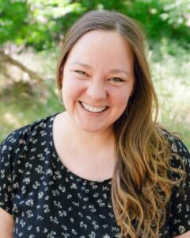
A Christian Ministry in the National Parks
Leader: Amy Kennedy
Location: US - Nationwide
Did you know?
ACMNP offers 1,400 Sunday services each summer.
25-35% of seasonal park employees are international, so their ministry reaches a global community.
Prayer Request:
Please pray for Dave Degler as he retires from his role as co-executive director of program and leadership and steps into a new season of life.

Slide 4
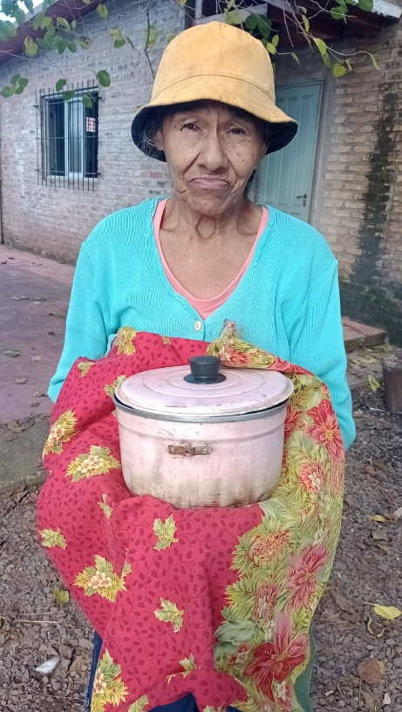
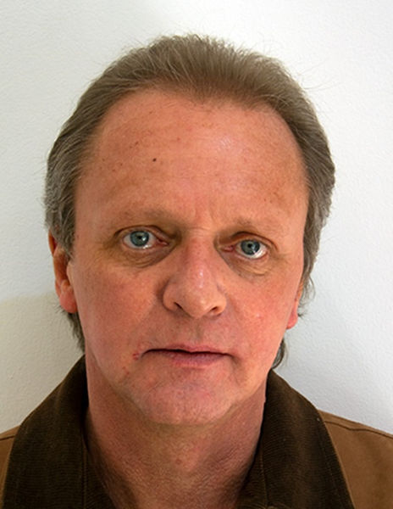
Asociacion Civil Cristiana Congregacional
Leader: Rev. Dr. Harding Stricker
Location: Argentina - Jardin America
Did you know?
ACCC recently inaugurated a new playground, creating a safe, welcoming space for children to play and grow.
In 2026, they are committed to funding clinic healthcare services, their soup kitchen and community garden, and providing essential school materials to youth.
Prayer Request:
Please keep the faith-grounded work of Asociacion Civil Cristiana Congregacional in your prayers as they strive to nurture health, education, and joy in their community.

Slide 5
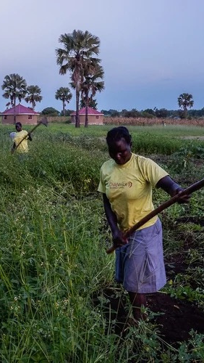
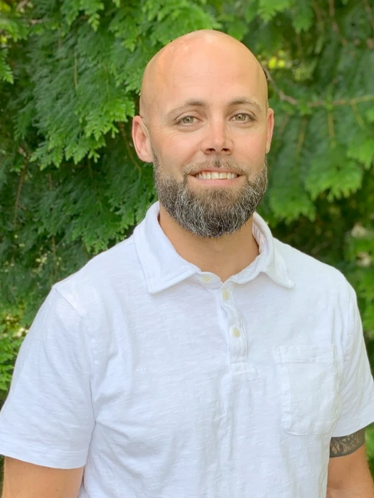
ChildVoice
Leader: Nathan Mandsager
Location: Uganda, South Sudan, and Nigeria
Did you know?
Since its founding, ChildVoice has served 15,373 kids and families.
263 girls have attended their Lukome Center, a non-traditional boarding school, 99% of whom have successfully completed their vocational training programs.
Prayer Request:
Please pray for ChildVoice’s new initiative working in north-eastern Nigeria. The Dauchi IDP community has about 100 households, and ChildVoice has already enrolled 97 people in their program to help improve the lives of local youth.

Slide 6
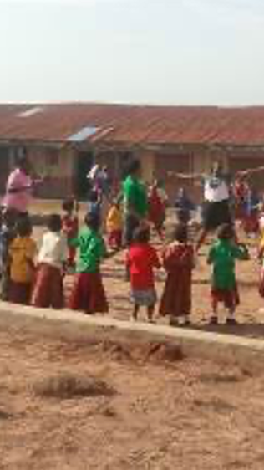
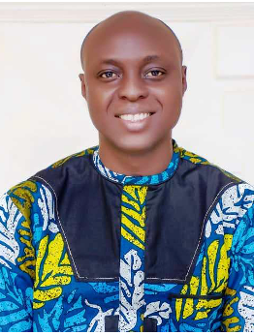
Christ to the Villages
Leader: Matthew Oladele
Location: Nigeria
Did you know?
Christ to the Villages believes in a deeply personal approach focused on individual connection, dedicated attention, and relationship building.
Following security-related disruptions and mandatory postponements last year, the operations of their nursery school, primary school, and college have resumed.
Prayer Request:
Please pray for total peace across Kwara State, their ability to afford fuel and transport as costs skyrocket, and the successful expansion of their solar electricity project to provide more reliable power and water pumping.

Slide 7
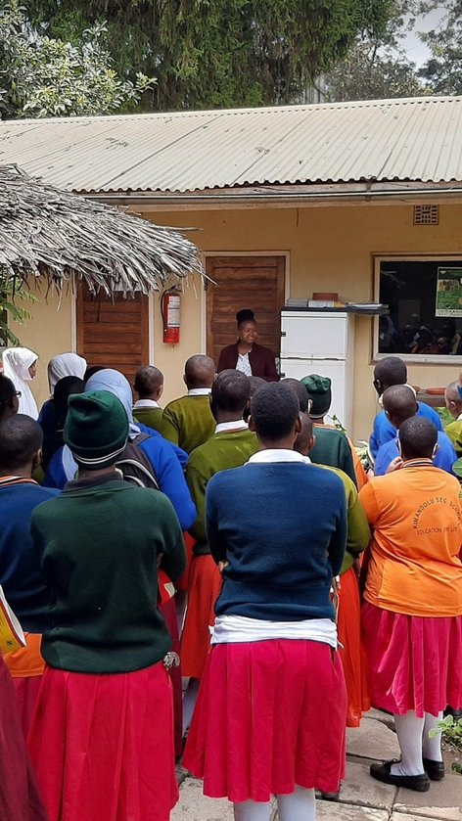
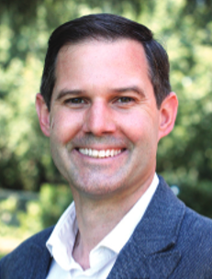
Educational Concerns for Hunger Organization
Leader: Abram Bicksler
Location: Florida
Did you know?
ECHO has impacted millions of lives by teaching small-scale, sustainable farming methods so families can provide for themselves and their communities.
They distributed 11,998 seed packets last year and provided agricultural training to 6,530 people.
Prayer Request:
Please pray for the success of ECHO’s Fully Forward Together global initiative, advancing their 2024–2029 Strategic Framework to strengthen local leaders, restore food systems, and partner with the global church to reduce hunger and improve lives.

Slide 8
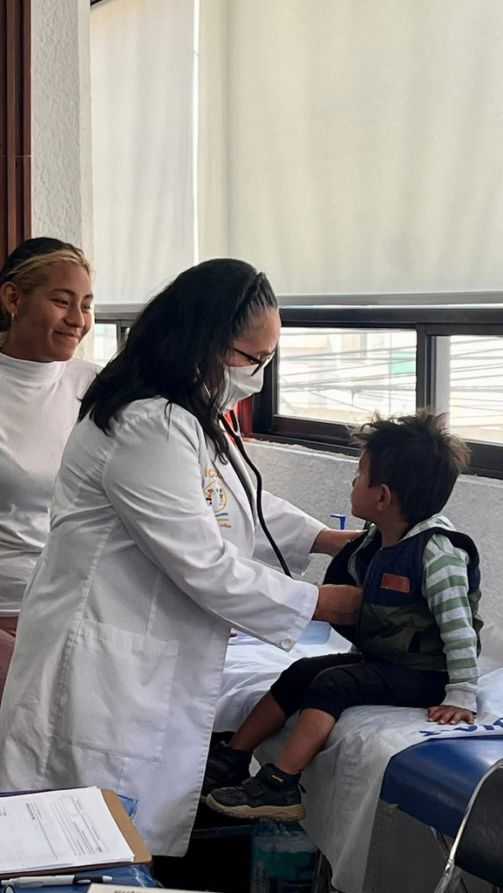
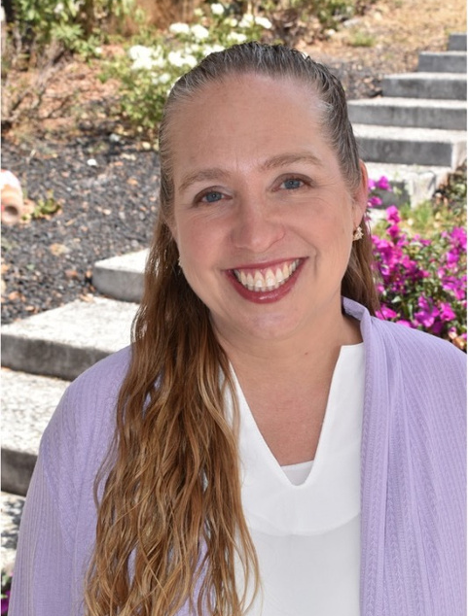
Fishers of Men
Leader: Julie Claassen
Location: Mexico
Did you know?
During their March Evangelistic Medical Mission Caravan, Fishers of Men was able to provide medical services to 382 people.
Their Refuge Ranch, located in central Mexico, provides a new home and forever family for children in need of love and care.
Prayer Request:
Please pray for Fishers of Men’s Mending Nets ministry - a developing program aimed at strengthening pastors spiritually and emotionally, enabling them to be more effective in their ministry.

Slide 9
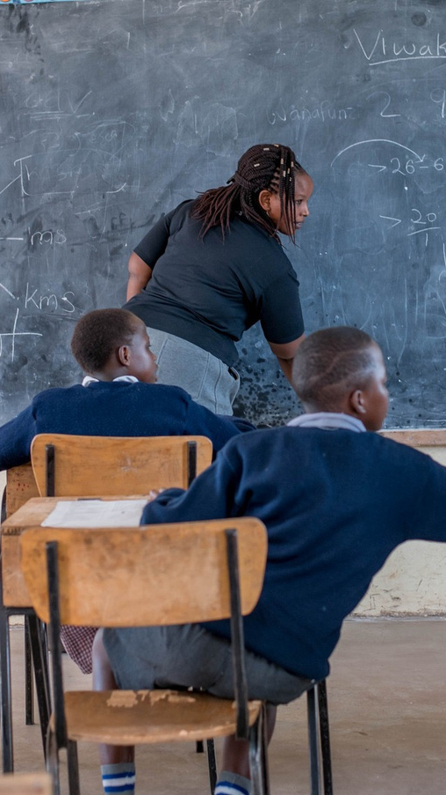
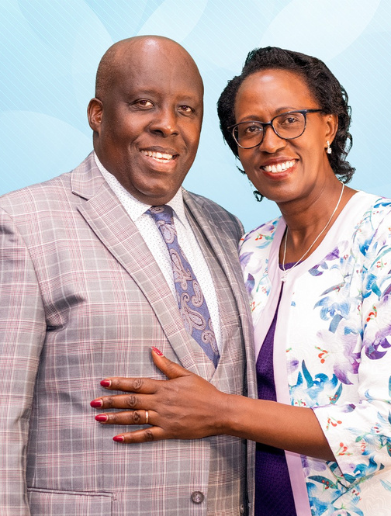
Happy Life Children’s Home
Leader: Revs. Peter and Faith Ndungu
Location: Kenya
Did you know?
Happy Life Mission gives hope to abandoned children by providing a loving home and the hope for adoption, supplying a quality education and job training, and offering quality holistic medical care.
Their mission hospital provides top-notch, 24-hour life-saving care to residents of Nairobi and its surrounding areas.
Prayer Request:
Please pray for the promise-filled futures of the multiple new children who have been taken into the care of Happy Life Children’s home in the last few months, as well as all the children who were already in their loving care.

Slide 10
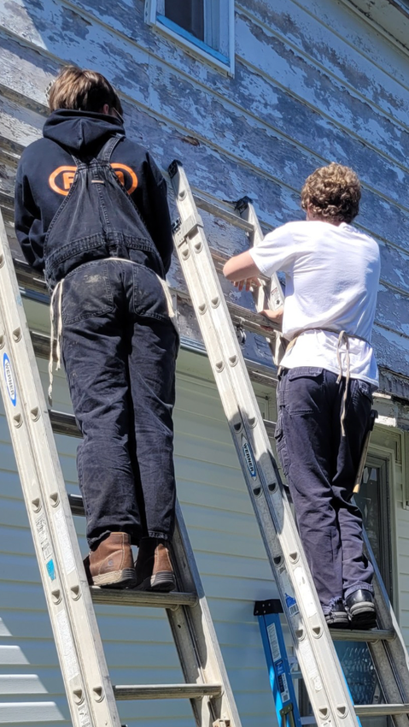
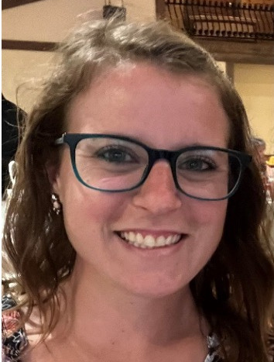
Hosanna Industries
Leader: Katie DeJournette
Location: Pennsylvania
Did you know?
Hosanna Industries provides critical home repairs and new construction in service of their belief that everyone should have a safe and secure place to live.
They currently serve in southwestern Pennsylvania, but offer their assistance elsewhere on occasion for disaster relief.
Prayer Request:
Please pray for the success of Hosanna’s upcoming fundraising event - Sporting Clays. Every shot fired will help provide critical home repairs for local families in need, and the event will bring the community together in support of a good cause.

Slide 11
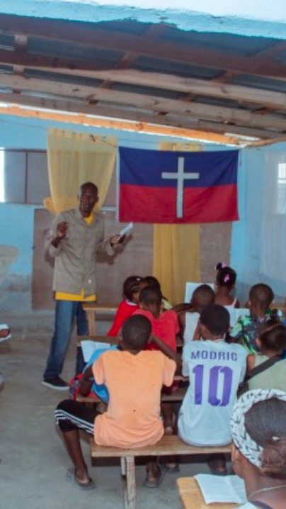
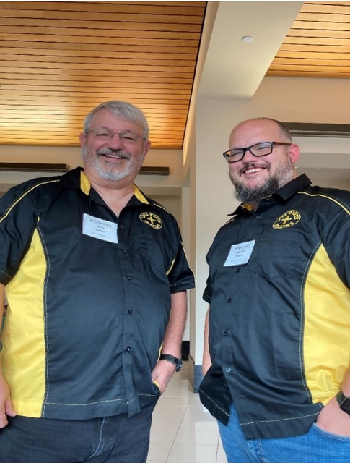
Love Worth Sharing
Leader: Rev. Jim Owens
Location: Haiti
Did you know?
Love Worth Sharing helps meet the needs of the Haitian people, especially children, by providing education, nourishment, and safety.
Haiti is currently experiencing a catastrophic, multi-layered humanitarian crisis in which more than 5.7 million people face acute food insecurity, and 1.4 million have been displaced by gang violence.
Prayer Request:
Please pray for the ministry staff serving faithfully in Haiti, for the children and families of Haiti who are struggling to survive each week, for peace and stability in the country, and for continued provisions for Love Worth Sharing’s feeding programs, medical care, and outreach.

Slide 12

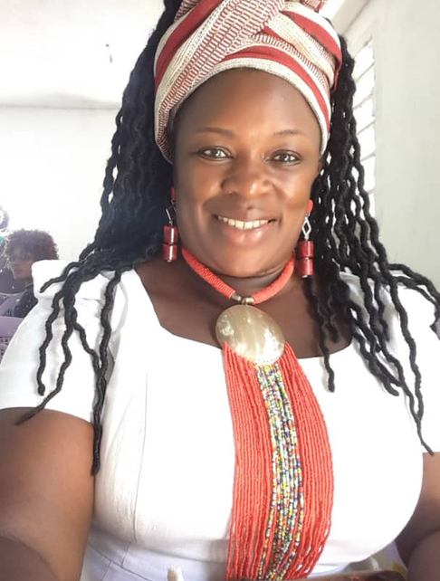
Mission School of Hope
Leader: Beatrice Ntube Diffang
Location: Cameroon
Did you know?
Mission School of Hope educates, feeds, and provides healthcare for 600 Baka children and their communities in eastern Cameroon.
In 2025, they celebrated their students achieving a 100% pass rate on the national middle school entrance exams.
Prayer Request:
Please pray for the continued nourishment of minds, feeding of bodies, and shaping of destinies of the children supported by Mission School of Hope, as well as for strength and grace for Beatrice as she leads the mission forward after Rev. Sagay’s passing.

Slide 13
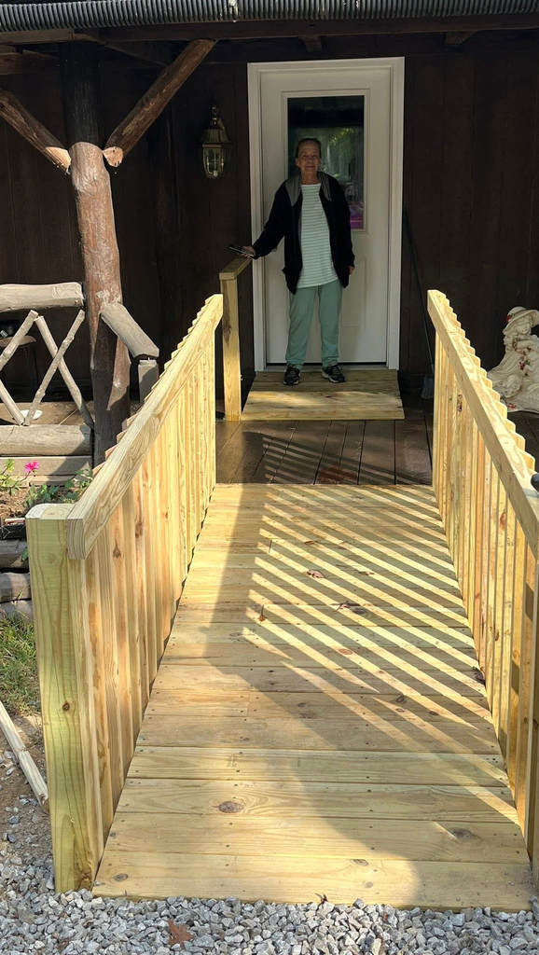
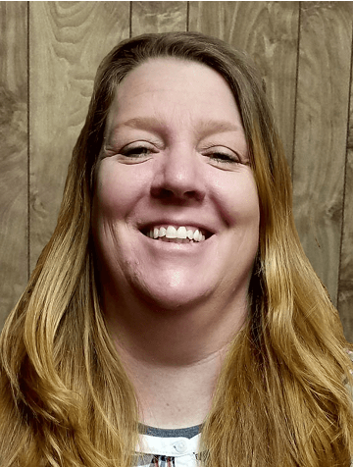
Morgan Scott Project
Leader: Crystal Tompkins
Location: Tennessee
Did you know?
29% of families in Tennessee’s Morgan and Scott counties fall below the poverty line - the Morgan Scott Project strives to help break the cycle of poverty.
By developing activities, providing training, and assisting with basic needs, they enable those in need to help themselves.
Prayer Request:
Please pray for the strength of the Morgan Scott Project team as they continue their efforts to serve those in need, break cycles of poverty, and empower individuals and communities with hope, dignity, and lasting support.

Slide 14
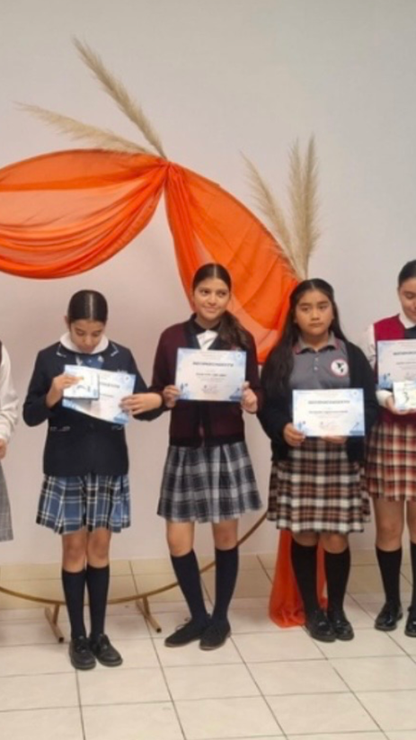
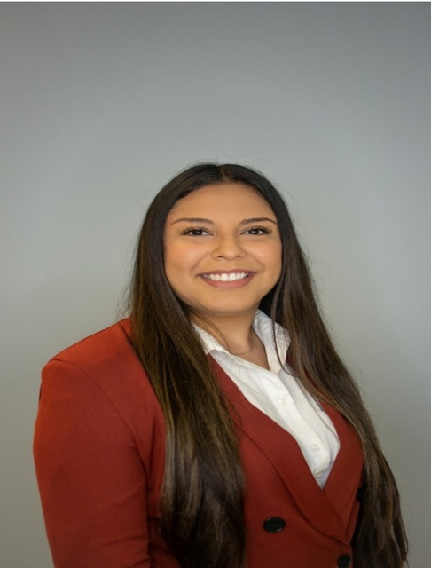
Panamerican Institute
Leader: Laura Ramirez
Location: Mexico
Did you know?
Through a new collaboration with the Autonomous University of Baja California, Panamerican Institute is bringing in university interns to lead history and literature workshops for their students.
The school has successfully applied for inclusion in state and municipal civil society catalogs, which will provide access to grants and service discounts.
Prayer Request:
Please pray that the Panamerican Institute receives the generous donations they need to support the costs of the uniforms and bus fares their students need to attend school.

Slide 15
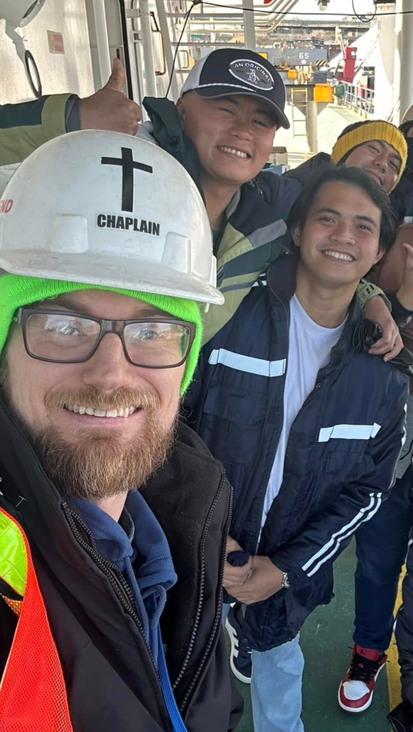
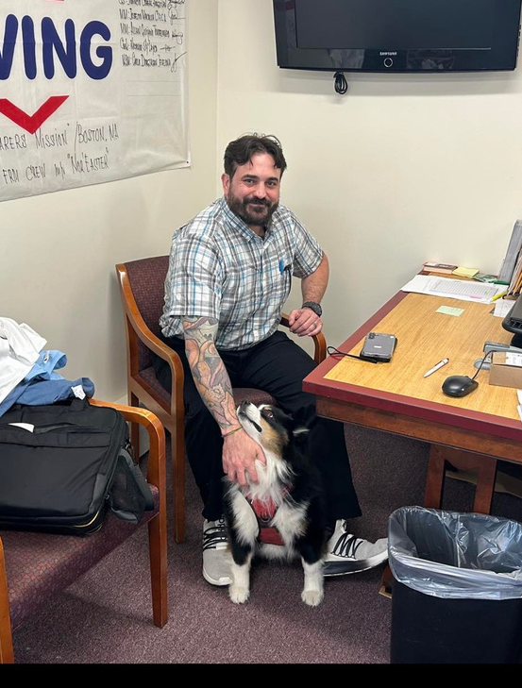
Seafarer’s Friend
Leader: Rev. David Hulse
Location: Massachusetts, New Hampshire, and Maine
Did you know?
Seafarers spend 6–9 months (sometimes longer) at a time working at sea, far away from their families, keeping global trade moving.
Seafarer’s Friend strives to ensure seafarers feel at home in their port locations, advocates for the rights of seafarers across the globe, and provides spiritual guidance and pastoral care for seafarers seeking support.
Prayer Request:
Please pray for Seafarer’s Friend’s success in their new initiative to open a Seafarer Center in Boston. They’ve found the perfect location, now they just need the financial support that will allow them to afford it.

Slide 16
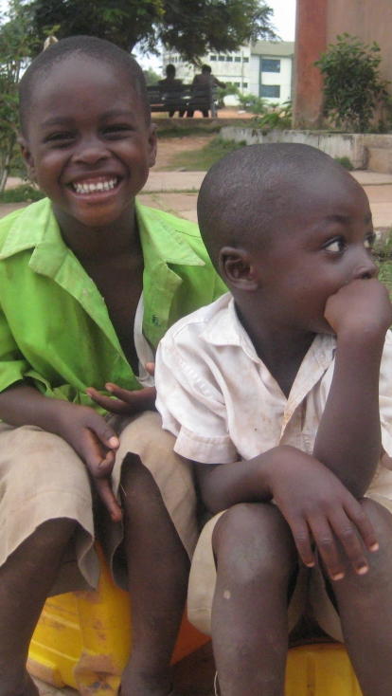
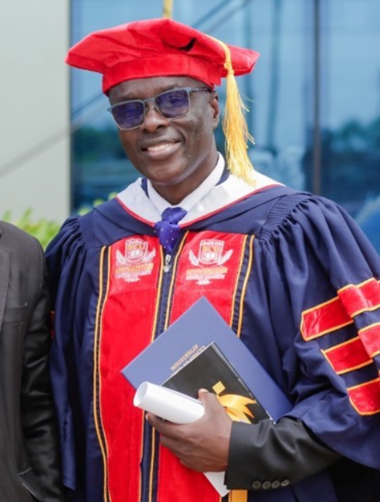
Word Alive Mission
Leader: Rev. Dr. Charles Nyane
Location: Ghana and Ivory Coast
Did you know?
Rev Dr. Charles Nyane recently visited and organized revival services for twenty churches in villages and towns in western Ghana.
Work to build a hospital facility for the mission is progressing. They hope to complete the block work by the end of the year and then move onto the project of roofing the structure.
Prayer Request:
Please pray for financial relief for Word Alive Mission. Recent needs, like the near total repair of a school bus and the construction of their hospital facility have caused the mission financial strain.

Slide 17




Affiliated Organizations
Congregational Library & Archives
University of Olivet
Piedmont University
Pilgrim Center for Reconciliation

